Slide 1
Data Analysis
With Python

Slide 2
Pandas DataFrame Function
DataFrame.append() | Add the rows of other dataframe to the end of the given dataframe.
DataFrame.apply() | Allows the user to pass a function and apply it to every single value of the Pandas series.
DataFrame.assign() | Add new column into a dataframe.
DataFrame.astype() | Cast the Pandas object to a specified dtype.astype() function.
DataFrame.concat() | Perform concatenation operation along an axis in the DataFrame.
DataFrame.count() | Count the number of non-NA cells for each column or row.
DataFrame.describe() | Calculate some statistical data like percentile, mean and std of the numerical values of the Series or DataFrame.
DataFrame.drop_duplicates() | Remove duplicate values from the DataFrame.
DataFrame.groupby() | Split the data into various groups.

Slide 3
Pandas DataFrame Function
DataFrame.head() | Returns the first n rows for the object based on position.
DataFrame.hist() | Divide the values within a numerical variable into "bins".
DataFrame.iterrows() | Iterate over the rows as (index, series) pairs.
DataFrame.mean() | Return the mean of the values for the requested axis.
DataFrame.melt() | Unpivots the DataFrame from a wide format to a long format.
DataFrame.merge() | Merge the two datasets together into one.
DataFrame.pivot_table() | Aggregate data with calculations such as Sum, Count, Average, Max, and Min.
DataFrame.query() | Filter the dataframe.
DataFrame.sample() | Select the rows and columns from the dataframe randomly.
DataFrame.shift() | Shift column or subtract the column value with the previous row value from the dataframe.

Slide 4
Pandas DataFrame Function
DataFrame.sort() | Sort the dataframe.
DataFrame.sum() | Return the sum of the values for the requested axis by the user.
DataFrame.to_excel() | Export the dataframe to the excel file.
DataFrame.transpose() | Transpose the index and columns of the dataframe.
DataFrame.where() | Check the dataframe for one or more conditions.

Slide 5
append()
DataFrame.append(other, ignore_index=False, verify_integrity=False, sort=None)
other: DataFrame or Series/dict-like object, or a list of these It refers to the data to be appended.
ignore_index: If it is true, it does not use the index labels.
verify_integrity: If it is true, it raises ValueError on creating an index with duplicates.
sort: It sorts the columns if the columns of self and other are not aligned. The default sorting is deprecated, and it will change to not-sorting in a future version of pandas. We pass sort=True Explicitly for silence the warning and the sort, whereas we pass sort=False Explicitly for silence the warning and not the sort.

Slide 6
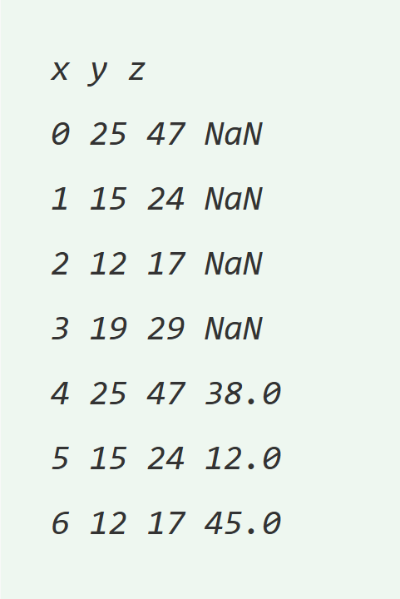
append() : example 1
import pandas as pd
# Create first Dataframe using dictionary
info1 = pd.DataFrame({"x":[25,15,12,19],
"y":[47, 24, 17, 29]})
# Create second Dataframe using dictionary
Info2 = pd.DataFrame({"x":[25, 15, 12],
"y":[47, 24, 17],
"z":[38, 12, 45]})
# append info2 at end in info1
info.append(info2, ignore_index = True)

Slide 7
aggregate() : [sum,min,max]
#Syntax
DataFrame.aggregate(func, axis=0, *args, **kwargs)
func: It refers callable, string, dictionary, or list of string/callables.
axis: (default 0): It refers to 0 or 'index', 1 or 'columns‘
*args: It is a positional argument that is to be passed to func.
**kwargs: It is a keyword argument that is to be passed to the func.

Slide 8
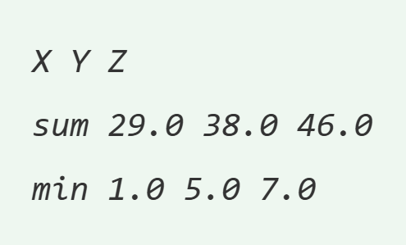
aggregate() : [sum,min,max]
import pandas as pd
import numpy as np
info=pd.DataFrame([[1,5,7],
[10,12,15],
[18,21,24],
[np.nan,np.nan,np.nan]],
columns=['X','Y','Z'])
info.agg(['sum','min'])

Slide 9
assign() :
The assign() method is also responsible for adding a new column into a DataFrame.
If we re-assign an existing column, then its value will be overwritten.
Syntax:
DataFrame.assign(**kwargs)
kwargs: keywords are the column names. These keywords are assigned to the new column if the values are callable. If the values are not callable, they are simply assigned.

Slide 10
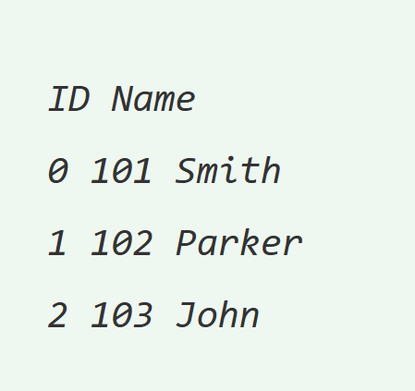
assign() : example
import pandas as pd
# Create an empty dataframe
info = pd.DataFrame()
# Create a column
info['ID'] = [101, 102, 103]
# View the dataframe
info
# Assign a new column to dataframe called 'age'
info.assign(Name = ['Smith', 'Parker', 'John'])

Slide 11
count() :
DataFrame.count(axis=0, level=None, numeric_only=False)
axis: {0 or 'index', 1 or 'columns'}, default value 0 0 or 'index' is used for row-wise, whereas 1 or 'columns' is used for column-wise.
level: int or str It is an optional parameter. If an axis is hierarchical, it counts along with the particular level and collapsing into the DataFrame.
numeric_only: bool, default value False It only includes int, float, or Boolean data.

Slide 12
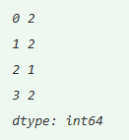
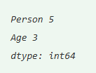
count() : example
import pandas as pd
import numpy as np
info = pd.DataFrame({"Person":["Parker", "Smith", "William", "John"],
"Age": [27., 29, np.nan, 32]
info.count(axis='columns’)
#info.count()

Slide 13
cut() :
pandas.cut(x, bins, right=True, labels=None, retbins=False, precision=3, include_lowest=False, duplicates='raise')
x: It generally refers to an array as an input that is to be bin. The array should be a one-dimensional array.
bins: It refers to an int, sequence of scalars, or IntervalIndex values that define the bin edges for the segmentation.
retbins: It refers to a boolean value that checks whether to return the bins or not.
precision: It is used to store and display the bins labels. It consists of an integer value that has the default value 3.

